Slide 1

Object Oriented Programming

Slide 2

Pick a Problem you want to solve by OOP. Identify
Noun – Class
Adjectives – Attributes
Verbs – Tasks that the object can perform

Slide 3
Classes
Car
Animals
Medicines
Hotels

Slide 4
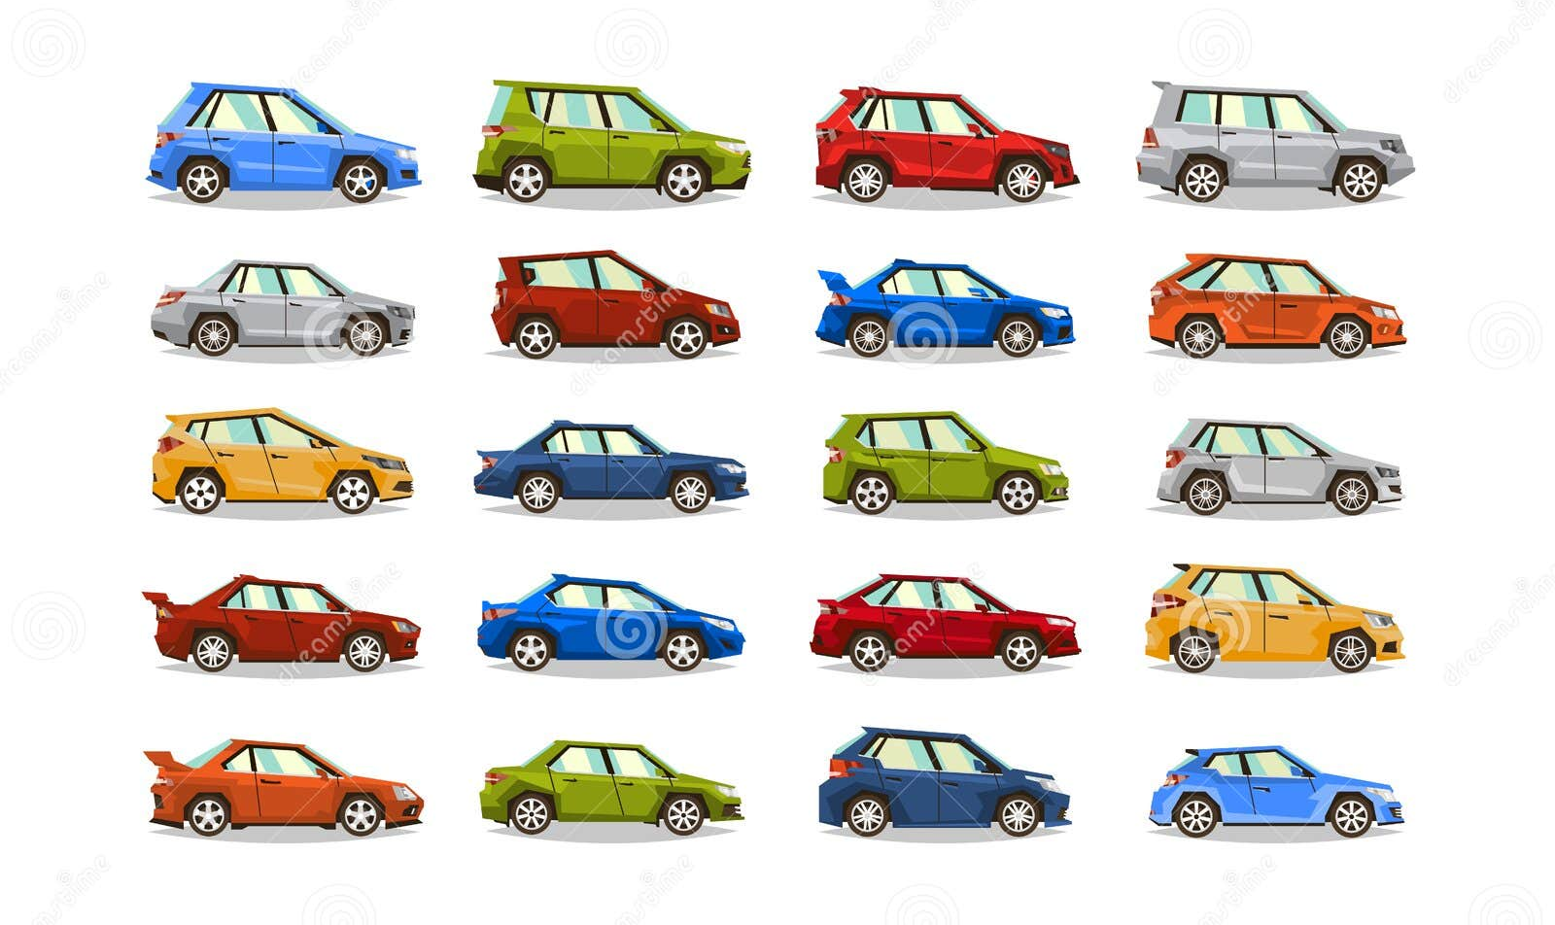
Attributes

Slide 5
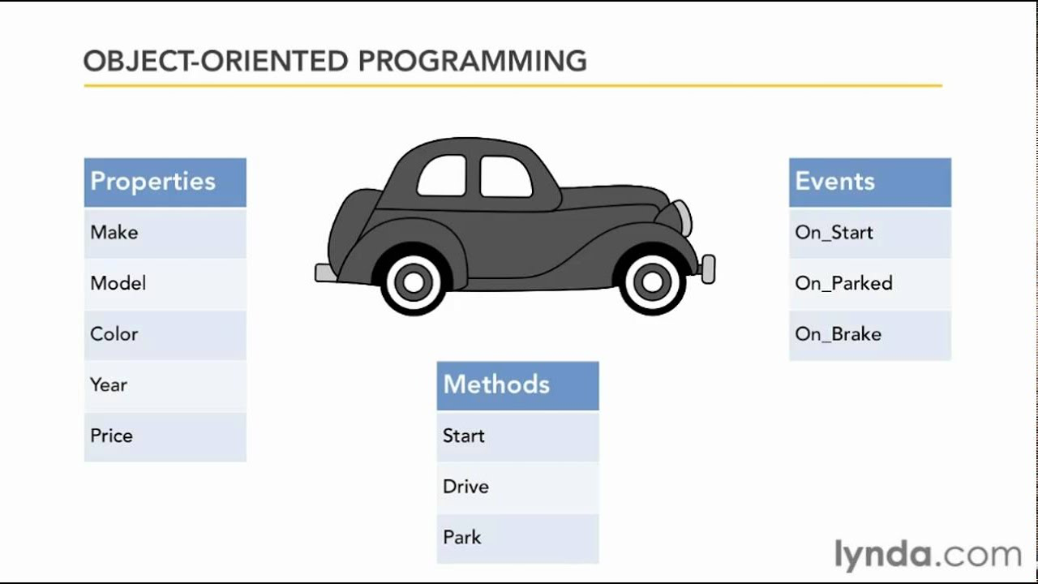

Slide 6
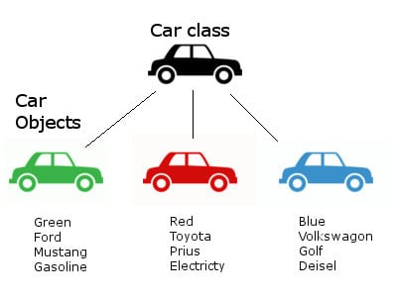

Slide 7
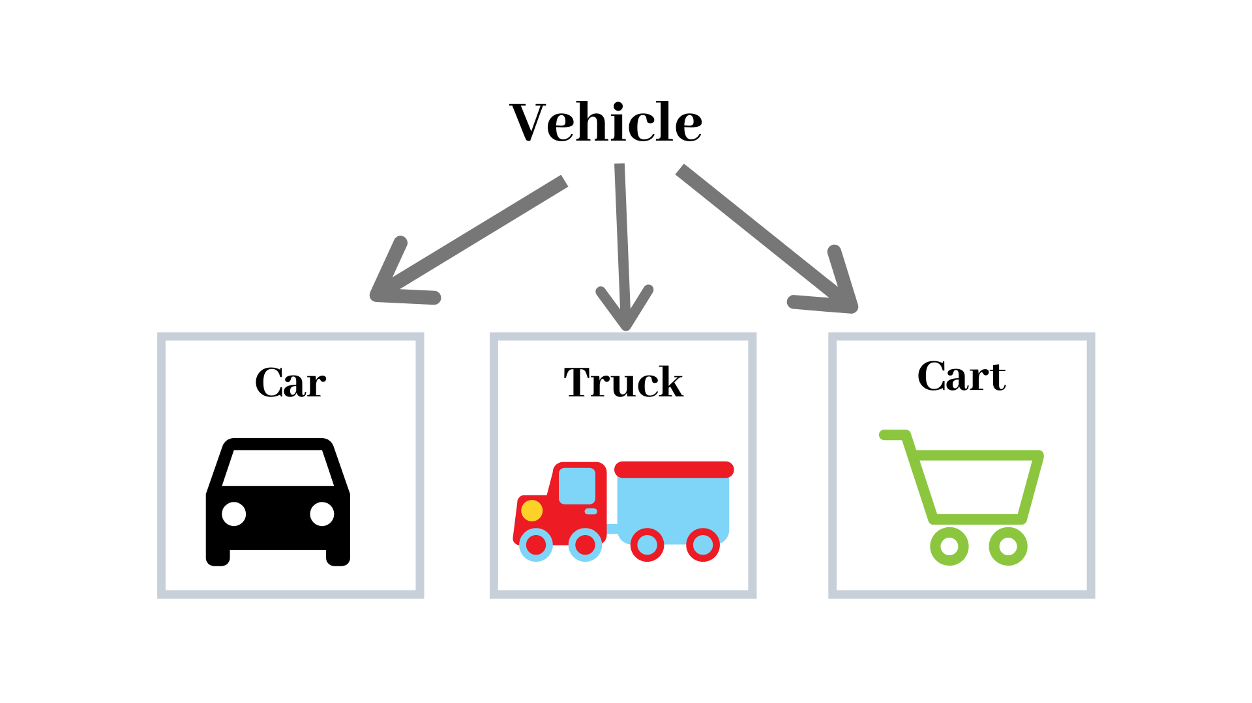

Slide 8
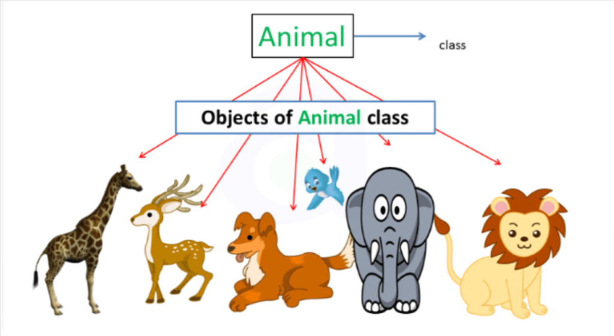

Slide 9
